Slide 1
Cybersecurity in the Age of ICT
Protecting Digital Assets in a Connected World
Name: Yash Raj
Roll No: 25K-0878

Slide 2
Agenda
Introduction
Importance of Cybersecurity
Common Cyber Threats
ICT Tools for Cybersecurity
Cybersecurity Process (SmartArt)
Advantages of Strong Cybersecurity
Challenges in Cybersecurity
Case Study (e.g., WannaCry Ransomware)
Future of Cybersecurity in ICT
Conclusion
Q&A / Thank You

Slide 3
Introduction
ICT = Information & Communication Technology
Used in education, healthcare, business, banking, governance
More ICT use → higher cyber risks
Cybersecurity = protecting:
Devices
Networks
Data
Goal: Ensure confidentiality, integrity, availability (CIA Triad)

Slide 4
Importance of Cybersecurity
Protects Sensitive Data → personal, financial, government
Ensures Business Continuity → prevents downtime, financial losses
Builds Trust → customers & users feel safe
Supports Digital Growth → encourages innovation in ICT

Slide 5
Common Cyber Threats
Viruses & Malware – disrupt or damage systems
Phishing – fake emails/websites to steal information
Ransomware – hackers lock data until payment is made
Data Breaches – theft of confidential data
Insider Threats – careless or malicious employees

Slide 6
ICT Security Tools
Firewall
Encryption
Antivirus
MFA
IDS
Top Layer: Firewalls (first defense)
Second Layer: Encryption
Third Layer: Antivirus & Anti-malware
Fourth Layer: Multi-Factor Authentication
Bottom Layer: Intrusion Detection Systems

Slide 7
Cybersecurity Process
Identify – Assess potential risks
Protect – Apply controls (firewalls, encryption)
Detect – Monitor & find suspicious activities
Respond – Stop attacks quickly
Recover – Restore systems & learn from incidents
Identify
Protect
Detect
Respond
Recover

Slide 8
Advantages of Cybersecurity
Protects Data & Privacy → avoids leaks
Maintains Reputation → customers trust secured organizations
Legal Compliance → meets data protection laws (GDPR, etc.)
Supports Innovation → organizations can safely use ICT

Slide 9

Challenges in Cybersecurity
Advanced Hacking → AI-driven cyber attacks
High Costs → expensive tools & systems
Lack of Professionals → shortage of skilled cybersecurity experts
Human Error → weak passwords, phishing victims

Slide 10
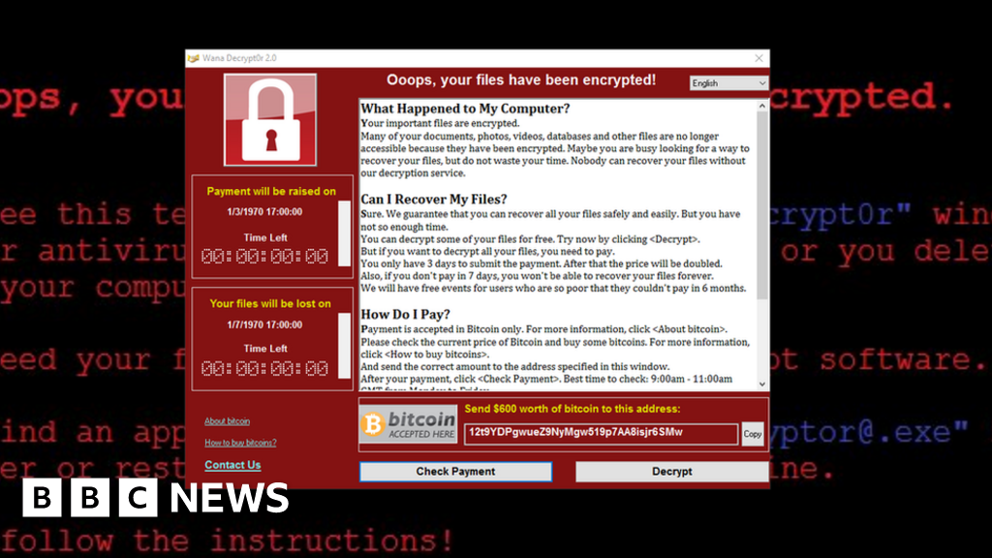
Case Study: WannaCry (2017)
Ransomware attack spread worldwide
Infected 200,000+ computers across 150 countries
Affected hospitals, businesses, governments
Caused losses of billions of dollars
Lesson: Regular updates & patches are essential

Slide 11
Future of Cybersecurity
AI-based Defense → detects attacks in real time
Cloud Security → protecting online storage & SaaS
Zero-Trust Security → "Never trust, always verify" model
Blockchain → for secure transactions & data integrity
Awareness Programs → training individuals against attacks

Slide 12
Conclusion
ICT brings opportunities & risks
Cybersecurity ensures safe digital growth
Strong defense protects individuals, businesses & governments
Everyone (users + organizations) plays a role in cybersecurity

Slide 13
Q&A
Thank You

